Slide 1

Energy Storage Systems

Slide 2
Batteries suitable for use in vehicles(Rechargeable)
Lead acid batteries
Lithium ion batteries
Metal air batteries
nickel iron
nickel cadmium
nickel metal hydride
sodium sulphur and sodium metal chloride.

Slide 3
Comparison of batteries as per current EV technology

Slide 4
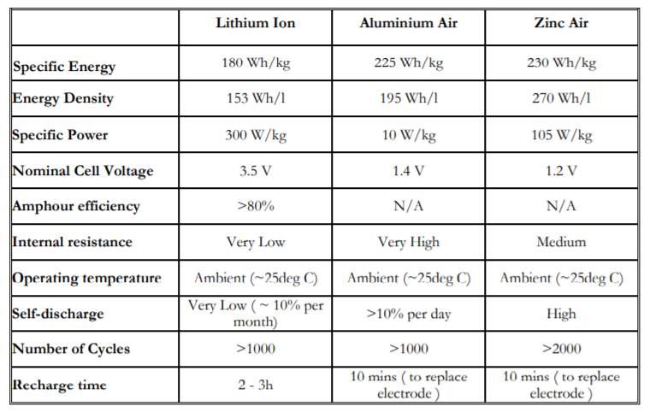
Comparison of batteries as per current EV technology

Slide 5
Lead Acid Batteries
Advantages: Lead-acid batteries have been the most popular choice of batteries for EVs.
Lead-acid batteries can be designed to be high powered and are inexpensive, safe, and reliable. Relatively low cost • Easy availability of raw materials (lead, sulphur) • Ease of manufacture • Favorable electromechanical characteristics ,A recycling infrastructure is in place for them
Disadvantages: low specific energy, poor cold temperature performance, and short calendar and cycle life are among the obstacles to their use in EVs and HEVs.

Slide 6
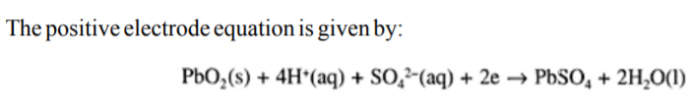

CELL DISCHARGE OPERATION(PBA)
In the cell discharge operation ,electrons are consumed at the positive electrode, the supply of which comes from the negative electrode. The current flow is, therefore, out of the positive electrode into the motor-load, with the battery acting as the source.

Slide 7
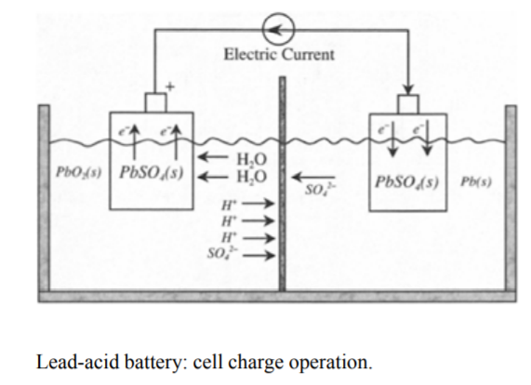
CELL CHARGE OPERATION(PBA)

Slide 8
NICKEL-CADMIUM BATTERY
The NiCd battery employs
positive electrode: nickel oxide
negative electrode : metallic cadmium
Electrolyte: the potassium hydroxide (KOH)
The net reaction occurring in the potassium hydroxide (KOH) electrolyte is:

Slide 9
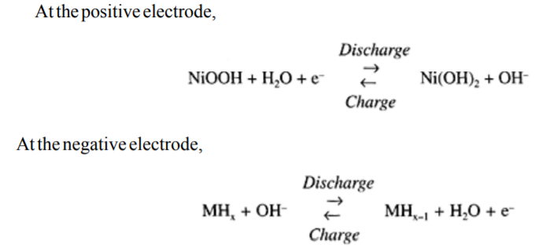
NICKEL-METAL-HYDRIDE (NiMH) BATTERY
positive electrode -nickel oxide similar to that used in a NiCd battery
negative electrode -metal hydride where hydrogen is stored.
The concept of NiMH batteries is based on the fact that fine particles of certain metallic alloys, when exposed to hydrogen at certain pressures and temperatures, absorb large quantities of the gas to form the metalhydride compounds. Furthermore, the metal hydrides are able to absorb and release hydrogen many times without deterioration. The two electrode chemical reactions in a NiMH battery are:
M stands for metallic alloy, which takes up hydrogen at ambient temperature to form the metal hydride MHX

Slide 10
Advantages & disadvantages
Advantages:
much longer life cycle than lead-acid batteries safe and abuse tolerant.
Disadvantages:
high cost, higher self-discharge rate compared to NiCd, poor charge acceptance capability at elevated temperatures, and low cell efficiency.
NiMH is likely to survive as the leading rechargeable battery in the future for traction applications

Slide 11
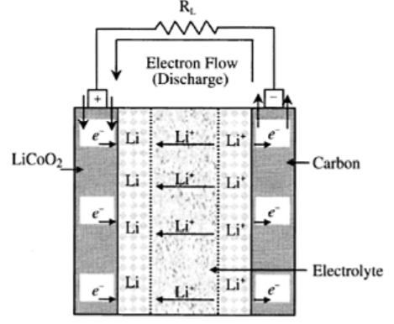
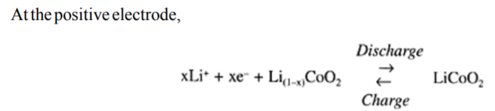
LI-ION BATTERY
During cell charge operation, lithium ions move in the opposite direction from the positive electrode to the negative electrode.
The nominal cell voltage for a Li-ion battery is 3.6 V, which is equivalent to three NiMH or NiCd battery cells.
Lithium-ion batteries have high specific energy, high specific power, high energy efficiency, good high-temperature performance, and low self-discharge.
The components of Li-ion batteries are also recyclable.
These characteristics make Li-ion batteries highly suitable for EV and HEV and other applications of rechargeable batteries.
Disadvantages: safety& cost

Slide 12
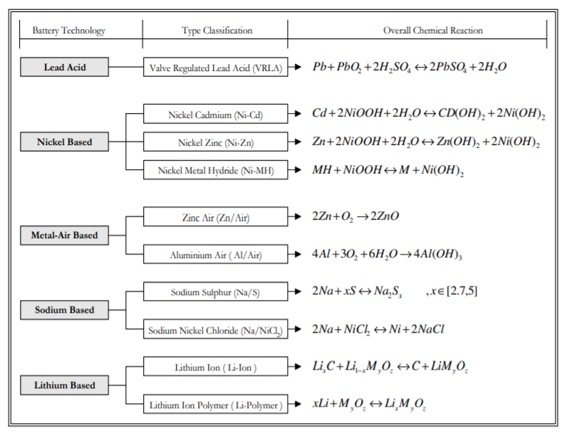

Slide 13
Alternative Energy Sources
The possible alternatives to batteries as portable energy sources that are being investigated today for electric vehicles (EVs) and hybrid electric vehicles (HEVs) and other applications are fuel cells and flywheels
Ultracapacitor technology has advanced tremendously in recent years, although it is unlikely to achieve specific energy levels high enough to serve as the sole energy source of a vehicle
However, ultracapacitors in conjunction with a battery or fuel cell have the possibility of being excellent portable energy sources with sufficient specific energy and specific power for the next generation of vehicles.

Slide 14
Fuel Cells
fuel cell is an electrochemical device that produces electricity by means of a chemical reaction, much like a battery.
The major difference between batteries and fuel cells is that the latter can produce electricity as long as fuel is supplied, while batteries produce electricity from stored chemical energy and, hence, require frequent recharging.
The basic structure of a fuel cell consists of an anode and a cathode, similar to a battery. The fuel supplied to the cell is hydrogen and oxygen.

Slide 15
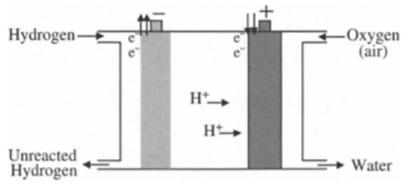
The flow of electrons from the anode to the cathode through the external circuit is what produces electricity. For the overall cell reaction to complete, oxygen or air must be passed over the cathode.
The cathode reaction takes place in two stages. First, the bond between the two oxygen atoms in the molecule breaks and then each ionized oxygen atom grabs two electrons coming from the anode through the external circuit to become negatively charged.
The negatively charged oxygen atoms are balanced by the positively charged hydrogen atoms at the cathode, and the combination produces H2O commonly known as water.
The chemical reaction taking place in a fuel cell is as follows:

Slide 16
There are several different types of fuel cells, each with strengths and weaknesses.
Low operating temperature is desirable for vehicle applications, despite the fact that higher temperatures result in higher reaction rates.
Rapid operation and co-generation capabilities are desirable for stationary applications.
Cogeneration refers to the capability to utilize the waste heat of a fuel cell to generate electricity using conventional means.

Slide 17
fuel cell for the vehicular application
Disdvantages: size, cost, efficiency, and start-up transient times of fuel cells are yet to be at an acceptable stage for EV and HEV applications.(under research)
The complexity of the controller required for fuel cell operation is another aspect that needs further attention.
Although its viability has been well-proven in the space program, as well as in prototype vehicles, its immature status makes it a longer-term enabling technology for an EV and HEV.

Slide 19
Electrolytic capacitor
Capacitors are devices that store energy by the separation of equal positive and negative electrostatic charges.
The basic structure of a capacitor consists of two conductors, known as plates, separated by a dielectric, which is an insulator.
The power densities of conventional capacitors are extremely high (~1012 W/m3 ), but the energy density is very low (~50 Wh/m3 ).
These conventional capacitors are commonly known as “electrolytic capacitors.” They are widely used in electrical circuits as intermediate energy storage elements for time constants that are of a completely different domain and are of much smaller order compared to the energy storage devices that are to serve as the primary energy sources for EVs. The capacitors are described in terms of capacitance, which is directly proportional to the dielectric constant of the insulating material and inversely proportional to the space between the two conducting plates. The capacitance is measured by the ratio of the magnitude of the charge between either plate and the potential difference between them (C=q/V).

Slide 20
Supercapacitors/ultracapacitor
Supercapacitors contain an electrolyte that enables the storage of electrostatic charge in the form of ions, in addition to conventional energy storage in electrostatic charges, like in an electrolytic capacitor.
The internal functions in a supercapacitor do not involve electrochemical reaction.
The electrodes in supercapacitors are made of porous carbon with high internal surface area to help absorb the ions and provide a much higher charge density than is possible in a conventional capacitor.
The ions move much more slowly than electrons, enabling a much longer time constant for charging and discharging compared to electrolytic capacitors.
Ultracapacitors are versions of electrolytic capacitors that use electrochemical systems to store energy in a polarized liquid layer at the interface between an ionically conducting electrolyte and an electrically conducting electrode.
Advantages:
On the other hand, supercapacitors and ultracapacitors with high specific power are suitable as an intermediate energy transfer device in conjunction with batteries or fuel cells in EVs and HEVs to provide sudden transient power demand, such as during acceleration and hill climbing.
The devices can also be used efficiently to capture recovered energy during regenerative braking.
Disadvantages: low energy density and high cost

Slide 21
Advantages &disadvantages in terms of ED&PD
Supercapacitors and ultracapacitors are derivatives of conventional capacitor
where energy density has been increased at the expense of power density to make the devices function more like a battery. Power density and energy density of supercapacitors and ultracapacitors are of the order of 106W/m3 and 104 Wh/m3 respectively.
Energy density is much lower compared to those of batteries (~5 to 25×104 Wh/m3 ), but the discharge times are much faster (110 s compared to ~5×103 s of batteries), and the cycle life is much more (~105 compared to 100 to 1000 of batteries).

Slide 22
FLYWHEEL
The flywheel is the kind of energy supply unit, that stores energy in mechanical form.
Flywheels store kinetic energy within a rotating wheel-like rotor or disk made of composite materials.
Flywheels can be used in HEVs with a standard IC engine as a power assist device.
flywheels can be used to replace chemical batteries in EVs to serve as the primary energy source or could be used in conjunction with batteries.
However, technological breakthroughs in increasing the specific energy of flywheels are necessary before they can be considered as the energy source for EVs and HEVs.
Drawback: complex, large, and heavy. Safety is also a concern with flywheels
Still research going on

Slide 23
Onboard energy storage
By using charging station:
Using energy storage for EV charging has some notable synergies with other benefits.
advantages:
Distributed storage for EV charging could be part of a localized strategy to integrate distributed photovoltaics and to provide very reliable electrical service in specific parts of the grid.
Charging at night when demand for electricity is low would smooth demand, thus reducing the utilities’ overall cost-of-service.

